Slide 1
The Next Decade of AI in Plant Breeding
From reading genomes to self-driving breeding programs · Course closing lecture
AI in Plant Breeding · closing lecture · 1 hours
Evidence base: 73 references published Oct 2023 – Oct 2026, each verified against its DOI or official source
Notes:
Welcome to the closing session. For the whole course you have used AI as a tool — writing analysis code with Claude Code, reading papers with agents. Today we invert the question: not 'how do I use AI', but 'what will AI *be* in breeding over the next 5–10 years, and what should I learn now to be part of it'. Everything in this deck is from Oct 2023 to Oct 2026 and every claim carries a reference on the slide. 73 references, all checked against their DOI or official source. Ground rule for today: enthusiasm, but always with evidence.

Slide 2
Three years. One field, rebuilt.
2023: a DNA model learns plant gene structure with no labels — and beats conservation scores
2024: a genome model designs working CRISPR systems; a 1B-parameter model reads 48 crop genomes
2025: robots phenotype ~200,000 plots; AI forecasts reach 38 million farmers
2026: AI-written science passes peer review in Nature; AI-designed genomes build viable phages
Benegas 2023 PNAS · Nguyen 2024 Science · Mendoza-Revilla 2024 Commun Biol · DeBruin 2025 Commun Biol · Google Research 2025 blog [company] · Lu 2026 Nature · King 2026 Science
Notes:
Open with scale, not with definitions. Each of these four lines is a verified result, not a projection. Ask the room: how many of these did you hear about when they happened? Usually very few hands. That is the point — the field is moving faster than the teaching material. Timing: 4 min. Tell them the deck is theirs afterwards, with every DOI, so they can go read the originals.
REFERENCES (verified):
• Benegas G et al. (2023). DNA language models are powerful predictors of genome-wide variant effects. PNAS. https://doi.org/10.1073/pnas.2311219120
• Nguyen E et al. (2024). Sequence modeling and design from molecular to genome scale with Evo. Science. https://doi.org/10.1126/science.ado9336
• Mendoza-Revilla J et al. (2024). A foundational large language model for edible plant genomes. Communications Biology. https://doi.org/10.1038/s42003-024-06465-2
• DeBruin J et al. (2025). Breaking the field phenotyping bottleneck in maize with autonomous robots. Communications Biology 8:467. https://doi.org/10.1038/s42003-025-07890-7
• Google Research & University of Chicago (2025). How AI is helping 38 million farmers with advance weather predictions. Google blog / UChicago Institute for Climate and Sustainable Growth. https://blog.google/innovation-and-ai/technology/research/indian-farmers-monsoon-prediction/
• Lu C et al. (2026). Towards end-to-end automation of AI research. Nature. https://doi.org/10.1038/s41586-026-10265-5
• King SH et al. (2026). Generative design of bacteriophages with genome language models. Science. https://doi.org/10.1126/science.aec2657

Slide 3
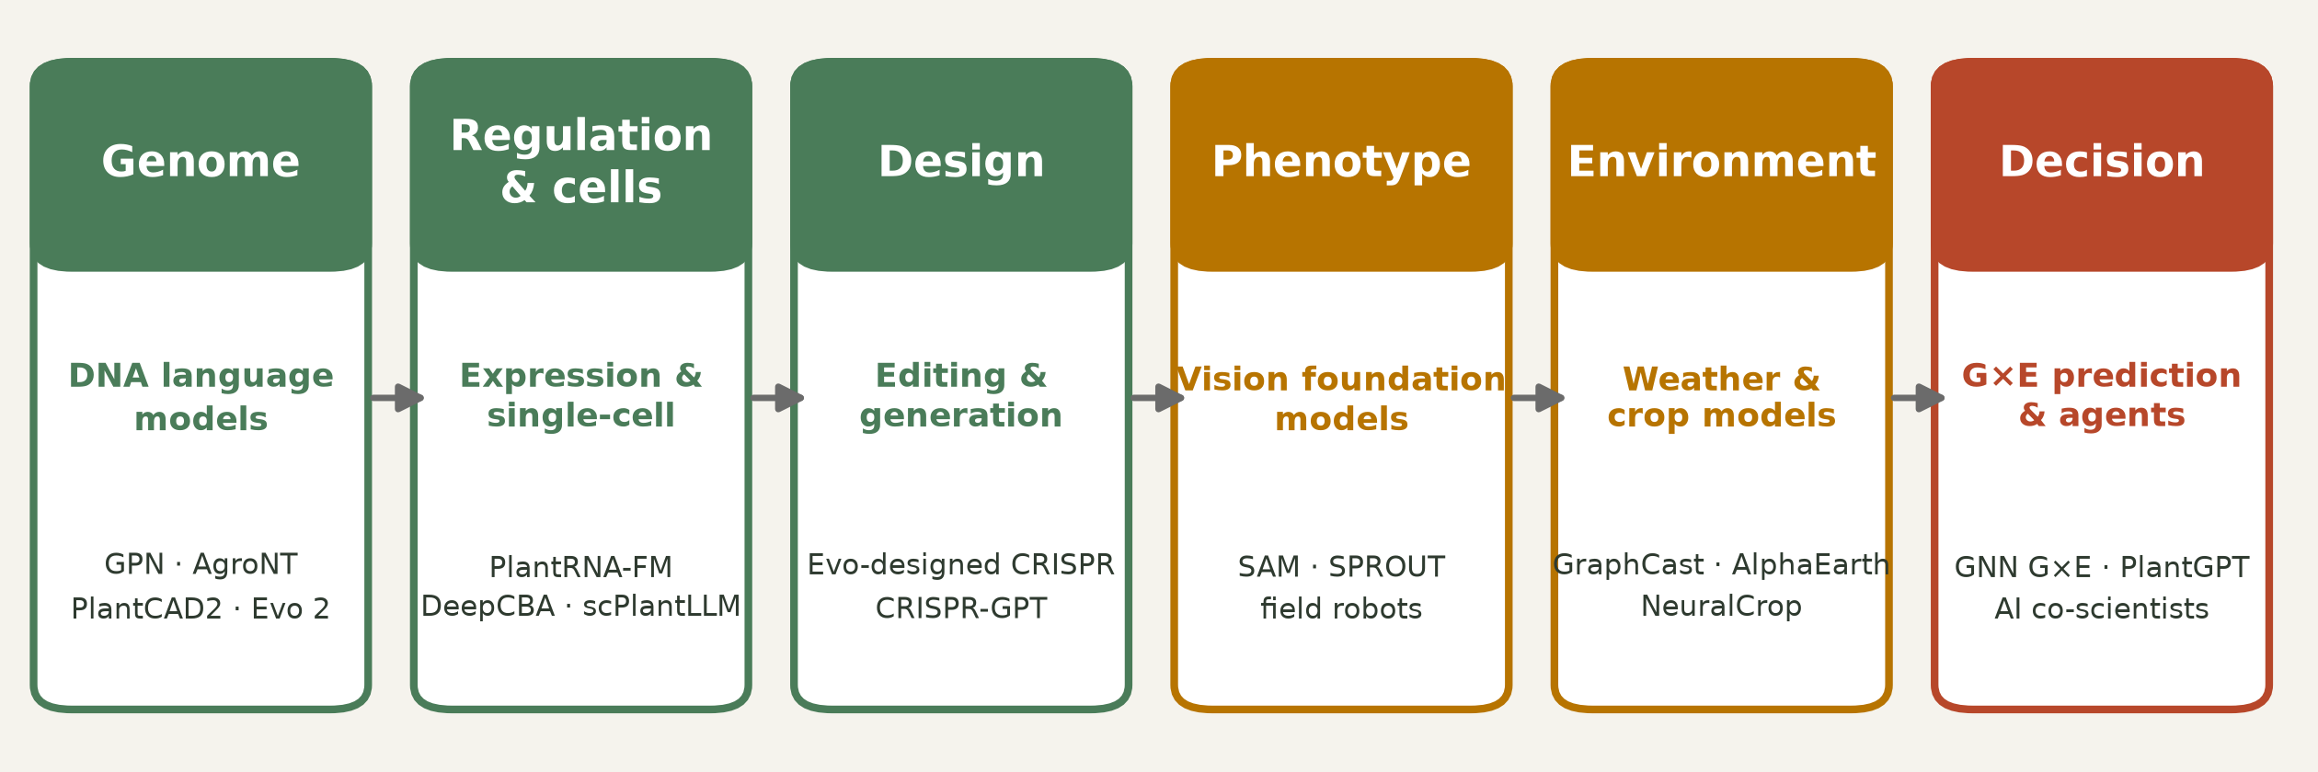
The whole pipeline is being rebuilt at once
Six places where AI entered plant breeding — this is the map for the next two hours
Zhai 2026 Cell Genomics · Yu 2024 Nat Mach Intell · Nguyen 2024 Science · Kirillov 2023 ICCV · Lam 2023 Science · Morshedian 2026 PLOS Comput Biol
Notes:
This is the map of the lecture. Left to right: genome → regulation → design → phenotype → environment → decision. The key message: these are not six separate AI projects, they are six interfaces of one loop, and they are converging. Point out that in 2020 only the 'decision' box (genomic prediction) had serious AI in breeding. Now every box does. Tell them we walk left to right, then come back and close the loop at the end.
REFERENCES (verified):
• Zhai J et al. (2026). PlantCAD2: A DNA foundation model for interpreting genomes across flowering plants. Cell Genomics. https://doi.org/10.1016/j.xgen.2026.101329
• Yu H et al. (2024). An interpretable RNA foundation model for exploring functional RNA motifs in plants. Nature Machine Intelligence. https://doi.org/10.1038/s42256-024-00946-z
• Nguyen E et al. (2024). Sequence modeling and design from molecular to genome scale with Evo. Science. https://doi.org/10.1126/science.ado9336
• Kirillov A et al. (2023). Segment Anything. Proc. IEEE/CVF ICCV 2023, pp. 3992-4003. https://doi.org/10.1109/iccv51070.2023.00371
• Lam R et al. (2023). Learning skillful medium-range global weather forecasting. Science 382:1416-1421. https://doi.org/10.1126/science.adi2336
• Morshedian A & Domaratzki M (2026). LSTM-attention-guided graph neural networks for integrated genotype–Environment modeling in maize yield prediction. PLOS Computational Biology 22:e1013729. https://doi.org/10.1371/journal.pcbi.1013729

Slide 4
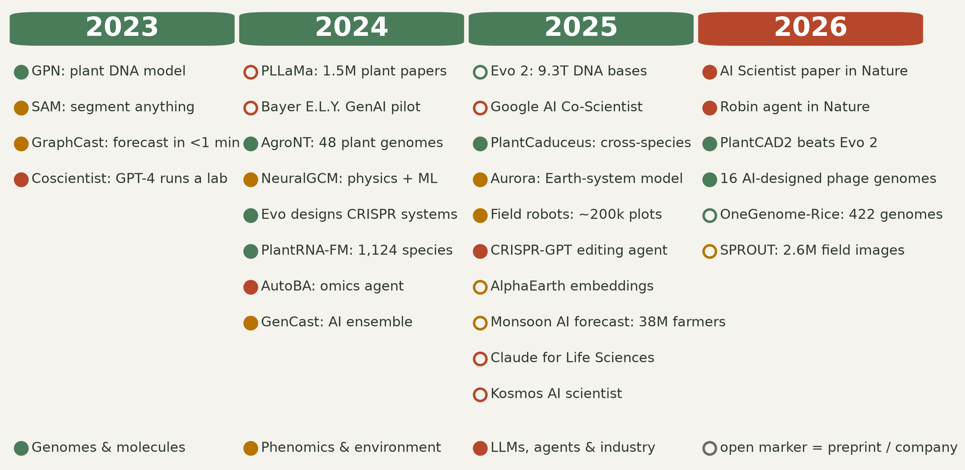
2023–2026: the milestones
Colour = domain · open marker = preprint or company announcement, not peer reviewed
Benegas 2023 PNAS · Kirillov 2023 ICCV · Lam 2023 Science · Boiko 2023 Nature · Mendoza-Revilla 2024 Commun Biol · Nguyen 2024 Science · Brixi 2025 bioRxiv [preprint] · Zhai 2025 PNAS · DeBruin 2025 Commun Biol · Anthropic launch 2025, reported by CNBC [news] · Lu 2026 Nature · Zhai 2026 Cell Genomics
Notes:
Let them read for 30 seconds in silence. Then make two observations. First, the density increases every year — 2026 is only 10 months old in this list. Second, note the open markers: a large part of the frontier is preprints and company announcements. That is a methodological warning we will return to at the end: exciting is not the same as validated. Ask: which of these would change your own project if it were true? Timing: 5 min.
REFERENCES (verified):
• Benegas G et al. (2023). DNA language models are powerful predictors of genome-wide variant effects. PNAS. https://doi.org/10.1073/pnas.2311219120
• Kirillov A et al. (2023). Segment Anything. Proc. IEEE/CVF ICCV 2023, pp. 3992-4003. https://doi.org/10.1109/iccv51070.2023.00371
• Lam R et al. (2023). Learning skillful medium-range global weather forecasting. Science 382:1416-1421. https://doi.org/10.1126/science.adi2336
• Boiko DA et al. (2023). Autonomous chemical research with large language models. Nature. https://doi.org/10.1038/s41586-023-06792-0
• Mendoza-Revilla J et al. (2024). A foundational large language model for edible plant genomes. Communications Biology. https://doi.org/10.1038/s42003-024-06465-2
• Nguyen E et al. (2024). Sequence modeling and design from molecular to genome scale with Evo. Science. https://doi.org/10.1126/science.ado9336
• Brixi G et al. (2025). Genome modeling and design across all domains of life with Evo 2. bioRxiv. https://doi.org/10.1101/2025.02.18.638918
• Zhai J et al. (2025). Cross-species modeling of plant genomes at single-nucleotide resolution using a pretrained DNA language model. PNAS. https://doi.org/10.1073/pnas.2421738122
• DeBruin J et al. (2025). Breaking the field phenotyping bottleneck in maize with autonomous robots. Communications Biology 8:467. https://doi.org/10.1038/s42003-025-07890-7
• Capoot A (CNBC) (2025). Anthropic launches Claude Life Sciences to give researchers an AI efficiency boost. CNBC. https://www.cnbc.com/2025/10/20/anthropic-claude-life-sciences-research-ai.html
• Lu C et al. (2026). Towards end-to-end automation of AI research. Nature. https://doi.org/10.1038/s41586-026-10265-5
• Zhai J et al. (2026). PlantCAD2: A DNA foundation model for interpreting genomes across flowering plants. Cell Genomics. https://doi.org/10.1016/j.xgen.2026.101329

Slide 5
Part 1 — Reading genomes
Foundation models that learn the language of plant DNA
Notes:
Section transition. We start with the layer closest to what breeders already do: the genome.

Slide 6
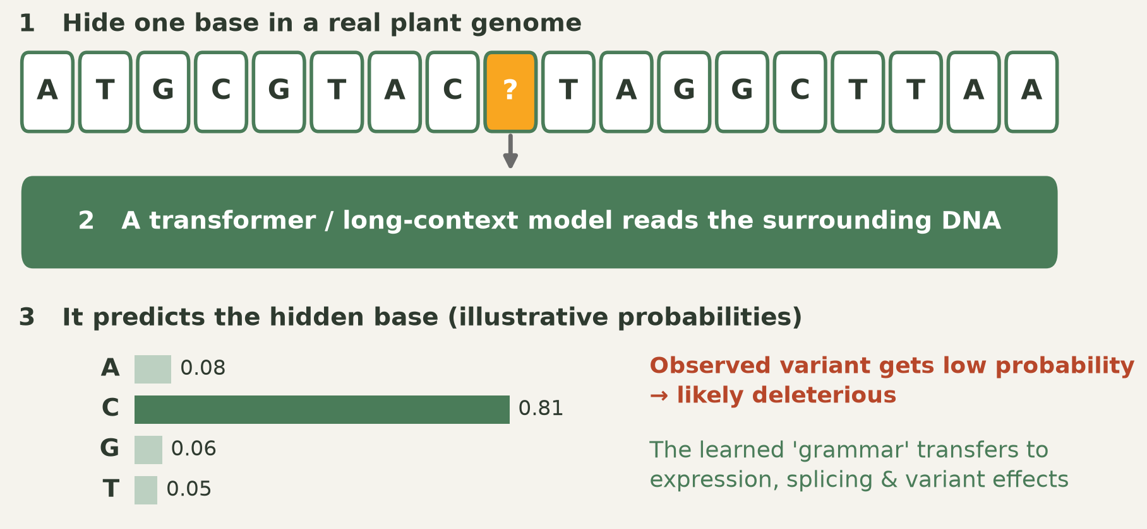
How a DNA language model learns
Same trick as a text LLM: hide a token, predict it, repeat billions of times
Benegas 2023 PNAS · Zhai 2025 PNAS
Notes:
This is the conceptual core of the section, so spend time here. The training task is trivial: mask a base, predict it from context. No phenotype labels, no annotation — just genomes. The consequence is not trivial: to predict well the model has to internalise gene structure, splice sites, codon bias, motifs. Then the trick: give it a real variant from your germplasm. If the model is 'surprised' by the allele, that position is probably under constraint — a candidate deleterious mutation. The probabilities shown are illustrative, drawn to explain the mechanism, not measured. Ask the students where they have seen this before — it is exactly masked language modelling from NLP.
REFERENCES (verified):
• Benegas G et al. (2023). DNA language models are powerful predictors of genome-wide variant effects. PNAS. https://doi.org/10.1073/pnas.2311219120
• Zhai J et al. (2025). Cross-species modeling of plant genomes at single-nucleotide resolution using a pretrained DNA language model. PNAS. https://doi.org/10.1073/pnas.2421738122

Slide 7
The first plant DNA models: GPN and AgroNT
GPN, trained unsupervised on Arabidopsis plus seven Brassicales genomes, learned gene structure and motifs with no labels — and predicted variant effects better than phyloP and phastCons
AgroNT: 1 billion parameters, genomes of 48 plant species, state of the art on regulatory annotation, promoter and terminator strength, tissue-specific expression
AgroNT scored more than 10 million cassava mutations in silico and released the Plants Genomic Benchmark
Both are open and downloadable — a student with a laptop and a Colab GPU can use them today
Benegas 2023 PNAS · Mendoza-Revilla 2024 Commun Biol
Notes:
GPN is the proof of principle (PNAS 2023): unsupervised learning on plant DNA beats decades-old comparative-genomics conservation scores at variant effect prediction. AgroNT is the crop-scale version. Emphasise the 10 million cassava mutations: an in-silico pre-screen of a mutation space no lab could assay. And emphasise 'open' — this is the practical hook. Invite them to try AgroNT on their own species as a course project.
REFERENCES (verified):
• Benegas G et al. (2023). DNA language models are powerful predictors of genome-wide variant effects. PNAS. https://doi.org/10.1073/pnas.2311219120
• Mendoza-Revilla J et al. (2024). A foundational large language model for edible plant genomes. Communications Biology. https://doi.org/10.1038/s42003-024-06465-2

Slide 8
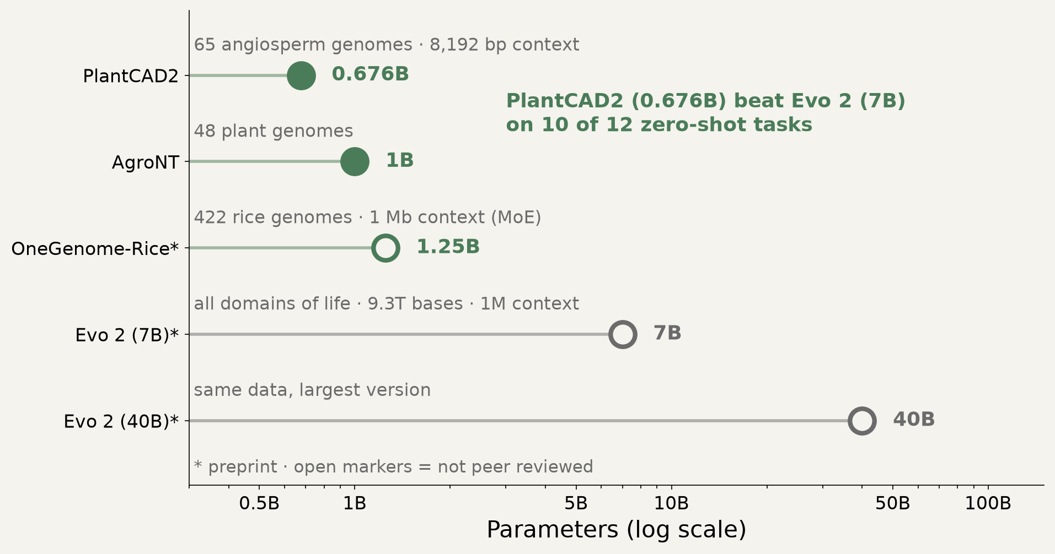
Specialist beats giant
PlantCAD2 (0.676B, 65 plant genomes) outperformed Evo 2 (7B, all domains of life) on 10 of 12 zero-shot tasks
Zhai 2026 Cell Genomics · Brixi 2025 bioRxiv [preprint] · Mantegazza 2026 Open Res Europe
Notes:
The most strategically important slide of Part 1. The general AI narrative is 'bigger is better'. In plants, the opposite held: a 676M-parameter plant specialist beat a 7B generalist on 10 of 12 zero-shot tasks, and beat 1B AgroNT on seven cross-species tasks. Longer context also mattered — maize accessible-chromatin AUPRC rose from 0.587 to 0.711. An independent test found Evo 2 does sense plant evolutionary constraint, but only modestly. Message for students: you do not need a frontier-lab budget to build something state of the art in plants. You need the right data. That is a thesis-sized opportunity.
REFERENCES (verified):
• Zhai J et al. (2026). PlantCAD2: A DNA foundation model for interpreting genomes across flowering plants. Cell Genomics. https://doi.org/10.1016/j.xgen.2026.101329
• Brixi G et al. (2025). Genome modeling and design across all domains of life with Evo 2. bioRxiv. https://doi.org/10.1101/2025.02.18.638918
• Mantegazza O et al. (2026). Evo 2’s perception of single nucleotide substitutions in the genes of two plant model organisms. Open Research Europe. https://doi.org/10.12688/openreseurope.24244.1

Slide 9
Part 2 — Predicting phenotypes
Genomic selection, G×E and the honest scoreboard
Notes:
Transition into the area closest to classical breeding practice. Warn them this section contains the least hype and the most rigour.

Slide 10
Deep learning vs GBLUP: an honest draw
The largest tuned head-to-head comparison — 14 real plant-breeding datasets — found no consistent winner
Deep learning was frequently ahead on smaller datasets, but only when hyperparameters were carefully tuned
Translation: architecture matters less than data quality, tuning and evaluation design
Reviews agree the real gain comes from multimodal fusion — genomes plus environment plus phenomics — at higher compute cost
Montesinos-López 2025 Front Genet · Montesinos-López 2024 Genetics
Notes:
Deliberately the least exciting slide, and I keep it because credibility depends on it. If someone tells you deep learning has replaced GBLUP, they have not read this comparison. For a student this is good news: an unresolved question with public data is exactly where a thesis can make a real contribution. Also a practical lesson — most published DL-beats-GBLUP claims come from weakly tuned baselines. Ask the class how they would design a fair comparison.
REFERENCES (verified):
• Montesinos-López A et al. (2025). Artificial intelligence meets genomic selection: comparing deep learning and GBLUP across diverse plant datasets. Frontiers in Genetics. https://doi.org/10.3389/fgene.2025.1568705
• Montesinos-López OA et al. (2024). A review of multimodal deep learning methods for genomic-enabled prediction in plant breeding. Genetics. https://doi.org/10.1093/genetics/iyae161

Slide 11
Measuring the E, and explaining the interaction
EXGEP, an ensemble of explainable models, predicted maize yield from 70,693 records on 3,793 hybrids, beating Bayesian ridge regression by 17.37–42.35%
SHAP values exposed which genetic and which environmental features drove each prediction — and how they interact
Perspective papers now argue for synchronised phenomics–enviromics data collection: satellites, UAVs, ground vehicles, indoor facilities
Public transcriptomes are an under-used input: models trained on 21,612 maize RNA-seq samples classified tissue, stage, cultivar and stress — though maize-trained models transferred poorly to rice
Yu 2025 Brief Bioinform · Li 2026 Nat Commun · Wu 2024 NAR Genom Bioinform
Notes:
The strongest gains in the last three years came from modelling the environment better, not the genome better. EXGEP is the example: large gains plus per-prediction explanations, which is what a breeder actually needs to act. The enviromics perspective is the programmatic version — treat the environment as something to be characterised as densely as the genome. The transcriptome result is both an opportunity and a caution: huge free training data, but transfer across species failed. That negative result is worth as much as the positive ones.
REFERENCES (verified):
• Yu T et al. (2025). EXGEP: a framework for predicting genotype-by-environment interactions using ensembles of explainable machine-learning models. Briefings in Bioinformatics. https://doi.org/10.1093/bib/bbaf414
• Li H et al. (2026). Omics-driven plant breeding through phenomics-enviromics crosstalk. Nature Communications. https://doi.org/10.1038/s41467-026-73097-x
• Wu Z et al. (2024). Phenotype prediction in plants is improved by integrating large-scale transcriptomic datasets. NAR Genomics and Bioinformatics. https://doi.org/10.1093/nargab/lqae184

Slide 12
Part 3 — Environment and growth
AI weather models, hybrid crop models and digital twins
Notes:
Transition. If G×E is the central problem of breeding, then modelling E well is half the solution.

Slide 13
From a Nature paper to 38 million farmers — in about a year
2024: NeuralGCM publishes hybrid physics-plus-ML climate simulation
2025: a blend of NeuralGCM, ECMWF's AIFS and historical data predicted Indian monsoon onset up to a month ahead, including an unusual mid-season dry spell
Forecasts were delivered by SMS to 38 million farmers with India's Ministry of Agriculture
Model choice was made with decision-oriented benchmarks: does it improve a sowing decision, not just a global error score
Kochkov 2024 Nature · Google Research 2025 blog [company] · Masiwal 2026 arXiv [preprint]
Notes:
This is the deployment slide, and it is the answer to 'is any of this real'. Roughly twelve months from a methods paper to SMS messages in farmers' hands at the scale of a large country. Be precise about status: the 38 million figure is from a company announcement, and the benchmarking paper is a preprint. The idea worth stealing is the last bullet — evaluate a model on whether it changes a decision, not on RMSE. Apply that to your own breeding models: does the prediction change which lines you advance?
REFERENCES (verified):
• Kochkov D et al. (2024). Neural general circulation models for weather and climate. Nature 632:1060-1066. https://doi.org/10.1038/s41586-024-07744-y
• Google Research & University of Chicago (2025). How AI is helping 38 million farmers with advance weather predictions. Google blog / UChicago Institute for Climate and Sustainable Growth. https://blog.google/innovation-and-ai/technology/research/indian-farmers-monsoon-prediction/
• Masiwal R et al. (2026). Decision-oriented benchmarking to transform AI weather forecast access: Application to the Indian monsoon. arXiv preprint. https://doi.org/10.48550/arxiv.2602.03767

Slide 14
Crop models learn to learn
Data assimilation plus stacked ML cut North China Plain winter-wheat forecast error from MAPE 7.79% to 1.74% (ACC 0.69 → 0.97)
NeuralCrop applies the NeuralGCM recipe to crops: a differentiable global crop model, trained to emulate process-based physiology then fine-tuned on observations — better under drought, orders of magnitude faster (preprint)
A mandarin digital twin over ~185,000 ha showed intra-orchard variation explains fruit quality far more than inter-orchard variation
Generative models already produce realistic future plot images conditioned on cultivar, time and treatment
Also arriving: AlphaEarth Foundations, annual global embedding layers for 2017–2024 — a free environmental covariate for multi-environment trials
Zhuang 2024 Agric For Meteorol 347 · Lin 2025 arXiv [preprint] · Kim 2024 Nat Commun · Drees 2024 Plant Methods · Brown 2025 arXiv / Google DeepMind [preprint]
Notes:
The convergence story. Process-based crop models encode physiology but fit data poorly; ML fits data but ignores physiology. Differentiable hybrids get both, and this is the single most likely architecture for the next generation of crop models. The digital twin result is a management lesson — variation within an orchard matters more than between orchards, which is the agricultural analogue of personalised medicine. The generative growth images hint at virtual field trials: screen genotypes across thousands of simulated environments before planting. And AlphaEarth is an immediately usable, free covariate layer — note it is a preprint.
REFERENCES (verified):
• Zhuang H et al. (2024). Integrating data assimilation, crop model, and machine learning for winter wheat yield forecasting in the North China Plain. Agricultural and Forest Meteorology 347:109909. https://doi.org/10.1016/j.agrformet.2024.109909
• Lin Y et al. (2025). NeuralCrop: Combining physics and machine learning for improved crop yield projections. arXiv preprint. https://doi.org/10.48550/arxiv.2512.20177
• Kim S & Heo S (2024). An agricultural digital twin for mandarins demonstrates the potential for individualized agriculture. Nature Communications 15:1561. https://doi.org/10.1038/s41467-024-45725-x
• Drees L et al. (2024). Data-driven crop growth simulation on time-varying generated images using multi-conditional generative adversarial networks. Plant Methods 20:93. https://doi.org/10.1186/s13007-024-01205-3
• Brown CF et al. (2025). AlphaEarth Foundations: An embedding field model for accurate and efficient global mapping from sparse label data. arXiv / Google DeepMind. https://doi.org/10.48550/arxiv.2507.22291

Slide 15
Part 4 — Agents
The tools you already use, pointed at research itself
Notes:
Transition, and the part that connects directly to what they did all semester.

Slide 16
From chatbot to co-scientist, in three years
Dec 2023: Coscientist, driven by GPT-4, designed and ran real experiments, including optimising palladium-catalysed cross-couplings
2025: Google's Co-Scientist evolved hypotheses in tournaments; quality kept rising with more test-time compute, and leukemia drug-repurposing candidates were validated in vitro (preprint)
2026: Robin, published in Nature, proposed and validated ripasudil for dry macular degeneration — then designed and analysed its own follow-up RNA-seq experiment
Kosmos runs up to 12 hours per task, executing ~42,000 lines of code and reading 1,500 papers; collaborators judged one 20-cycle run equivalent to about 6 months of their own research (preprint)
Boiko 2023 Nature · Gottweis 2025 arXiv [preprint] · Ghareeb 2026 Nature · Mitchener 2025 arXiv [preprint]
Notes:
Three years from 'can it run a reaction' to a Nature paper where an agent closed the full loop: literature → hypothesis → validation → next experiment designed by itself. The Kosmos number is the one that lands with students — six months of analysis in one overnight run, with every claim traceable to code or a paper. Keep the preprint flags visible. Then ask the room the uncomfortable question: if an agent does the analysis, what is the researcher for? The answer we will build toward is the question, the judgement and the field.
REFERENCES (verified):
• Boiko DA et al. (2023). Autonomous chemical research with large language models. Nature. https://doi.org/10.1038/s41586-023-06792-0
• Gottweis J et al. (2025). Accelerating scientific discovery with Co-Scientist (v1 title: Towards an AI co-scientist). arXiv. https://doi.org/10.48550/arxiv.2502.18864
• Ghareeb AE et al. (2026). A multi-agent system for automating scientific discovery. Nature. https://doi.org/10.1038/s41586-026-10652-y
• Mitchener L et al. (2025). Kosmos: An AI Scientist for Autonomous Discovery. arXiv. https://doi.org/10.48550/arxiv.2511.02824

Slide 17
Your coding agent is already a bioinformatician
AutoBA plans, runs and repairs end-to-end multi-omic analyses from minimal input — with local model options for data privacy
Biomni built its own toolkit by mining tools, databases and protocols from tens of thousands of publications across 25 biomedical domains (preprint)
CRISPR-GPT designs and analyses gene-editing experiments end to end
Claude for Life Sciences launched in Oct 2025 with connectors to lab and literature platforms including Benchling, PubMed and 10x Genomics
This is exactly what you did this semester — the research version of it is now the published state of the art
Zhou 2024 Adv Sci · Huang 2025 bioRxiv [preprint] · Qu 2025 Nat Biomed Eng · Anthropic launch 2025, reported by CNBC [news]
Notes:
Explicit callback to the course. What they practised — describe the analysis, let the agent write, run and fix the code — is the same pattern as AutoBA, which is a peer-reviewed method. Biomni is the interesting direction: an agent that assembles its own tools by reading the literature. There is no crop equivalent. 'Biomni for crops' is a genuinely fundable idea and I would like someone here to take it. Note the Anthropic launch is reported by a news outlet, not a paper.
REFERENCES (verified):
• Zhou J et al. (2024). An AI Agent for Fully Automated Multi-Omic Analyses. Advanced Science. https://doi.org/10.1002/advs.202407094
• Huang K et al. (2025). Biomni: A General-Purpose Biomedical AI Agent. bioRxiv. https://doi.org/10.1101/2025.05.30.656746
• Qu Y et al. (2025). CRISPR-GPT for agentic automation of gene-editing experiments. Nature Biomedical Engineering. https://doi.org/10.1038/s41551-025-01463-z
• Capoot A (CNBC) (2025). Anthropic launches Claude Life Sciences to give researchers an AI efficiency boost. CNBC. https://www.cnbc.com/2025/10/20/anthropic-claude-life-sciences-research-ai.html

Slide 18
Plant-science LLMs have arrived
In 2024 reviewers described the plant community as having largely not adopted LLMs; a 2025 breeding review still called their use in breeding 'largely unexplored'
PLLaMa extends LLaMa-2 with more than 1.5 million plant-science articles, with open checkpoints and a review panel that included plant breeders (preprint)
PlantGPT: an 8B model with retrieval over 60,000+ abstracts, fine-tuned on 13,993 Arabidopsis phenotypes and 23,323 gene functions, beats general LLMs on gene-function questions
PlantScience.ai maintains a self-updating, citation-grounded knowledge graph of the plant literature
Lam 2024 Trends Plant Sci · Yoosefzadeh-Najafabadi 2025 Front Plant Sci · Yang 2024 arXiv [preprint] · Zhang 2025 Adv Sci · Yu 2026 Mol Plant
Notes:
The gap between general AI and plant science is roughly two years — and it is closing fast. The PlantGPT result repeats the PlantCAD2 lesson at the language level: an 8B domain model with retrieval beats much larger general chatbots on specialist questions. Domain grounding beats scale. And PlantScience.ai addresses the problem the students felt all semester: general models invent citations, so a system that grounds every answer in a retrieved primary source is what research actually needs.
REFERENCES (verified):
• Lam HYI et al. (2024). Large language models in plant biology. Trends in Plant Science. https://doi.org/10.1016/j.tplants.2024.04.013
• Yoosefzadeh-Najafabadi M (2025). From text to traits: exploring the role of large language models in plant breeding. Frontiers in Plant Science. https://doi.org/10.3389/fpls.2025.1583344
• Yang X et al. (2024). PLLaMa: An Open-source Large Language Model for Plant Science. arXiv. https://doi.org/10.48550/arxiv.2401.01600
• Zhang R et al. (2025). PlantGPT: An Arabidopsis-Based Intelligent Agent that Answers Questions about Plant Functional Genomics. Advanced Science. https://doi.org/10.1002/advs.202503926
• Yu H et al. (2026). PlantScience.ai: An LLM-powered virtual scientist for plant science. Molecular Plant. https://doi.org/10.1016/j.molp.2026.03.010

